Slide 1
CELL2CELL:
PREDICTING CUSTOMER CHURN
TEAM M:
ABHILASH ALEXANDER ASTHA HARLALKA
BHAVESH JAIN
KRISHNASAI ADDALA
NIKITA SURYAWANSHI
18TH FEBRUARY, 2025

Slide 2

02
PURPOSE
Cell2Cell will use the results for:
Proactive Customer Retention
Optimized Marketing Spend
Improved Customer Experience
The primary marketing purpose of this analysis is to predict customer churn, enabling Cell2Cell to proactively retain high-risk customers with targeted strategies that boost loyalty and reduce revenue loss.
Expected Relationships between Churn and Predictive Variables:
Eqpdays (Equipment Days): Higher values → Higher churn
Revenue (Mean Monthly Revenue): Lower values → Higher churn
Retcall (Number of Retention Calls): Higher values → Higher churn
Notes:
The telecommunications market is reaching saturation, making customer retention a higher priority than customer acquisition for Cell2Cell. In this competitive landscape, predicting customer churn—identifying subscribers who are likely to leave the service—has become essential for developing proactive retention strategies and maintaining a stable customer base.
The primary marketing purpose of this analysis is to predict customer churn using Classification & Regression Trees (Decision Trees) and Logistic Regression to help Cell2Cell proactively retain high-risk customers before they decide to leave. By identifying patterns and drivers of churn, Cell2Cell can implement targeted retention strategies that increase customer loyalty and reduce revenue loss.

Slide 3
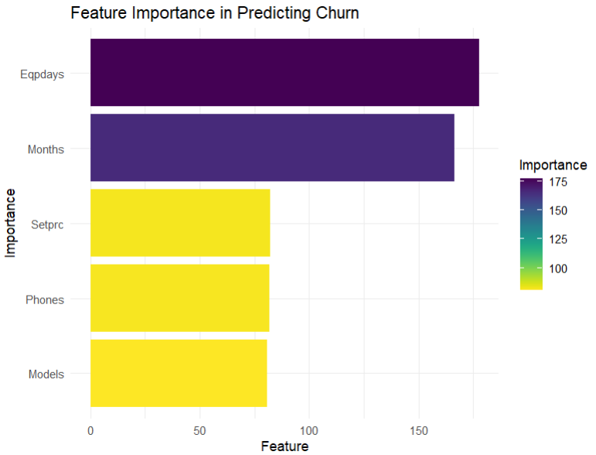

03
MODEL SUMMARY OF DECISION TREE
Decision Tree model highlighted these 5 feature relationships that affect churn chances the most:
Eqpdays (equipment days): Longer time with equipment slightly reduces churn risk.
Months (length of customer relationship): Longer customer relationships (more months) are typically associated with lower churn.
Setprc (set price): Higher-paying customers may expect more; if expectations are unmet, they are more likely to churn.
Phones: More number of phones per customer decreases likelihood of churn.
Models: Customers with more models are slightly less likely to churn.
For detailed insights, refer to the ‘Decision Tree’ Section in Reference Doc (also available in speaker notes)
Notes:
https://docs.google.com/document/d/1dVs0KeqlnrYNvQEQ3dsCsoaCSk9aCmdf/edit#heading=h.5c4rngu56f10

Slide 4
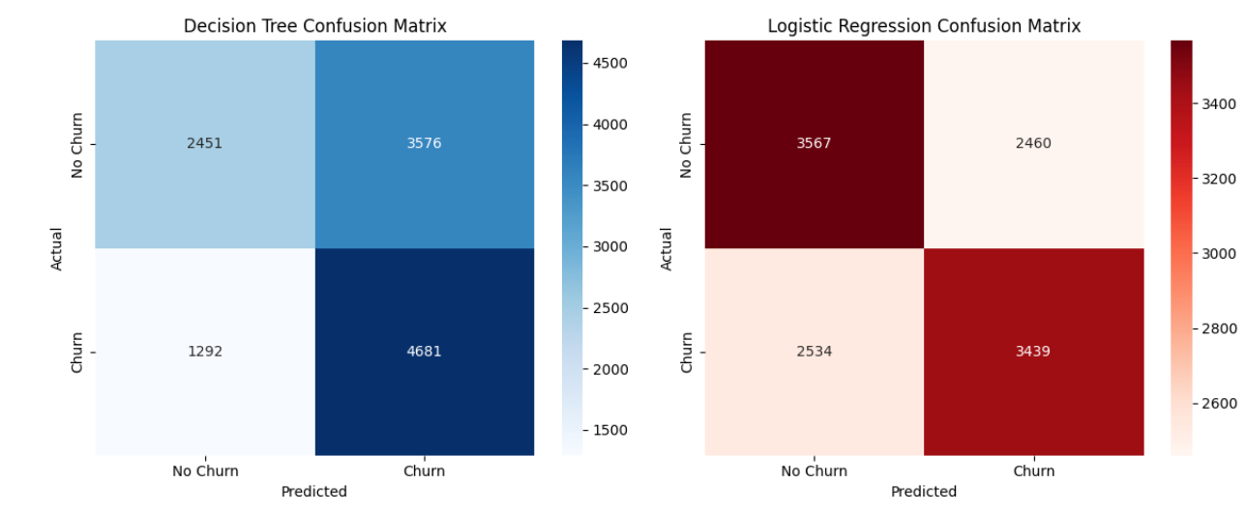
04
DECISION TREE-
CONFUSION MATRIX
PRECISION: 58.88% (HIGHER IS BETTER)
RECALL: 65.59% (HIGHER IS BETTER)
LIFT IN TOP DECILE: 1.33 (HIGHER IS BETTER)
ACCURACY: 60.03% (HIGHER IS BETTER)

Slide 5
05
MODEL SUMMARY OF LOGISTIC REGRESSION
The decision Tree model highlighted these 3 of the statistically important feature relationships that affect churn chances the most:
Eqpdays (equipment days):
For every additional month of the current equipment's number of days, the odds of churning versus not churning increase by 7.69%.
Refurb (Customers with refurbished handsets):
For customers with refurbished handsets, the odds of churning versus not churning increase by 29.5%.
Roam (Mean Roaming calls):
For every additional 10 calls of the mean number of roaming calls, the odds of churning versus not churning increase by 11.1%.
For detailed insights, refer to the ‘Logistic Regression’ Section in Reference Doc (also available in speaker notes)
Notes:
https://docs.google.com/document/d/1dVs0KeqlnrYNvQEQ3dsCsoaCSk9aCmdf/edit#heading=h.5c4rngu56f10

Slide 6
06
LOGISTIC REGRESSION- CONFUSION MATRIX
ACCURACY: 57.6%
PRECISION: 57.52%
RECALL: 57.06%
LIFT IN TOP DECILE: 1.30

Slide 7
07
RESOLVING THE CONFUSION
WHY DECISION TREE IS BETTER?
Higher Recall (65.59%) → Better at identifying churners.
Higher Lift in Top Decile (1.33) → More effective in targeting top churn-risk customers.
Better Overall Accuracy (60.03%) → Outperforms logistic regression in classification.
Recall Prioritization → Missing a churner is costlier than targeting a non-churner.
NEXT STEPS:
Prioritize recall over precision - The cost of missing a churner is higher than the cost of targeting a non-churner.
Focus on key churn features (Eqpdays, Retcall, Refurb, Dropvce)
Implement proactive retention strategies for high-risk customers based on the above identified features.

Slide 8
08
THE RETENTION PLAN
User 15747
Churn Probability: 77.29%
User 8695
Churn Probability: 77.29%
Offer:
Device Upgrade Discount with additional warranty
Loyalty Plan Incentive (Bonus minutes, lower monthly fees, bumper saver one time annual fees)
Personalized outreach (Reach out to the customer to understand what might be a concern)
Impact:
Churn probability expected to decrease significantly (by at least 30%) due to increased engagement and reduced dissatisfaction.
Offer:
Device Replacement Incentive bundled with an annual cellular plan
A month of free premium network service on subscribing to a 4 month plan to address dropped call concerns
Personalized outreach (Reach out to the customer to understand what might be a concern)
Impact:
Churn probability expected to decrease significantly (by about 40%) on addressing network concerns and offering an opportunity to get a better device
Notes:
Customer 15747 (Churn Probability: 77.29%)
Key Factors:
High equipment age (391 days), Likely dissatisfied with old device
No recorded interactions with retention team or mail promotions
No additional active subscriptions
Retention Offer:
Device Upgrade Discount: Has been using the device for more than a year and has a refurbished handset. Although having a refurbished handset is a good indicator and reduces the probability of churning, this would be a good time to provide good discounts so that the user can get a better device at a cheaper rate. Therefore, offer a discounted or free upgrade to a newer handset to reduce dissatisfaction with an old device.
Loyalty Plan Incentive: (Bonus minutes, lower monthly fees, bumper saver one time annual fees) - Make sure that you reward customers for being loyal.
Personalized outreach (Reach out to the customer to understand what might be a concern). As long as the issue can be feasibly resolved, do it. There is nothing that makes the customer happier than when the company acknowledges their problems and gives a solution. This is a very effective way of improving the loyalty amongst customers who may have been at the risk of churning.
Customer 8695 (Churn Probability: 77.29%)
Key Factors:
High equipment age (716 days) → Major risk factor for churn
No prior retention team interactions or mail promotions
Has multiple dropped voice calls (24 calls) → Possible network issues
Higher than average roaming usage (60.33 calls)
Retention Offer:
Device Replacement Incentive: Offer a free or deeply discounted phone upgrade to address dissatisfaction with an annual plan. Encouraging users to subscribe in annual plans helps reduce monthly churn rates.
Network Quality Assurance: Provide a free month of premium network service to address dropped call concerns.
Retention Outreach: Assign a customer service agent to personally call and discuss their needs.

Slide 9
09
THE RETENTION PLAN
User 29301
Churn Probability: 17.07%
User 34573
Churn Probability: 17.07%
Offer:
Minimal Intervention: Given that there is a low risk of churn, a simple appreciation email or small loyalty reward suffices
Cross-Sell Opportunity: Offer a free trial for an add-on feature
Impact:
Churn probability is expected to remain stable with probably a small decrease (~5%) on reinforcing the appreciation for the customer
Offer:
Loyalty Perk: Given the low risk of churn, send a thank you mail with a small account credit or free add-on to reinforce positive brand sentiment. Acknowledge that there has been some dropped calls and say that you are working on improving the same
Upsell Opportunity: Offer a premium service upgrade at a discount
Impact:
Churn probability is expected to remain stable with probably a small decrease (~5%) on reinforcing the appreciation for the customer
Notes:
Customer X29301 (Churn Probability: 17.07%)
Key Factors:
Low churn risk (already at 17%)
Engages with retention efforts (has at least 1 retention call)
Has an active subscription but no recorded roaming usage
Low credit rating - We don't want to give an offer that would be more of a short term gain and therefore, we don't want to invest too much on the user.
Retention Offer:
Minimal Intervention: Given the low churn risk, a subtle engagement approach like an appreciation email or small loyalty reward is sufficient.
Cross-Sell Opportunity: Offer a free trial for an add-on feature (e.g., data boost, international minutes) to increase engagement without unnecessary discounts.
Customer X34573 (Churn Probability: 17.07%)
Key Factors:
Low churn probability (17%)
Responds to mail promotions (high engagement)
Some dropped calls but not critical4. No additional active subscriptions
Retention Offer:
Loyalty Perk: Send a thank-you message with a small account credit or free add-on (extra data or premium customer support) to reinforce positive brand sentiment. Acknowledge that there has been some dropped calls and say that you are working on improving the same.
Upsell Opportunity: Suggest a premium service upgrade at a discount (e.g., unlimited plan, international roaming).

Slide 10
THANK YOU!

